Slide 1
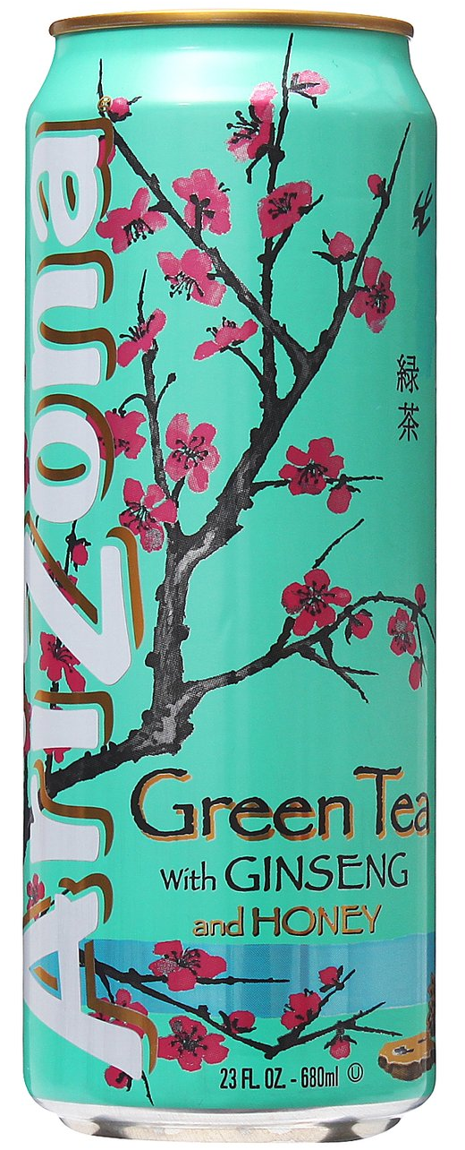

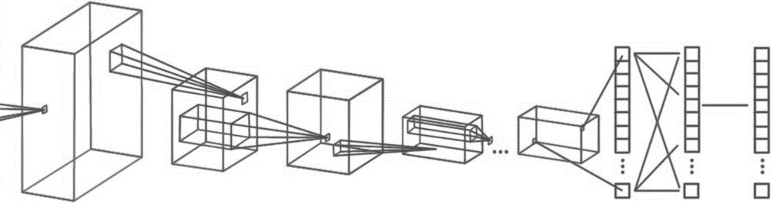
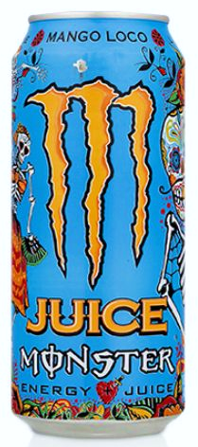
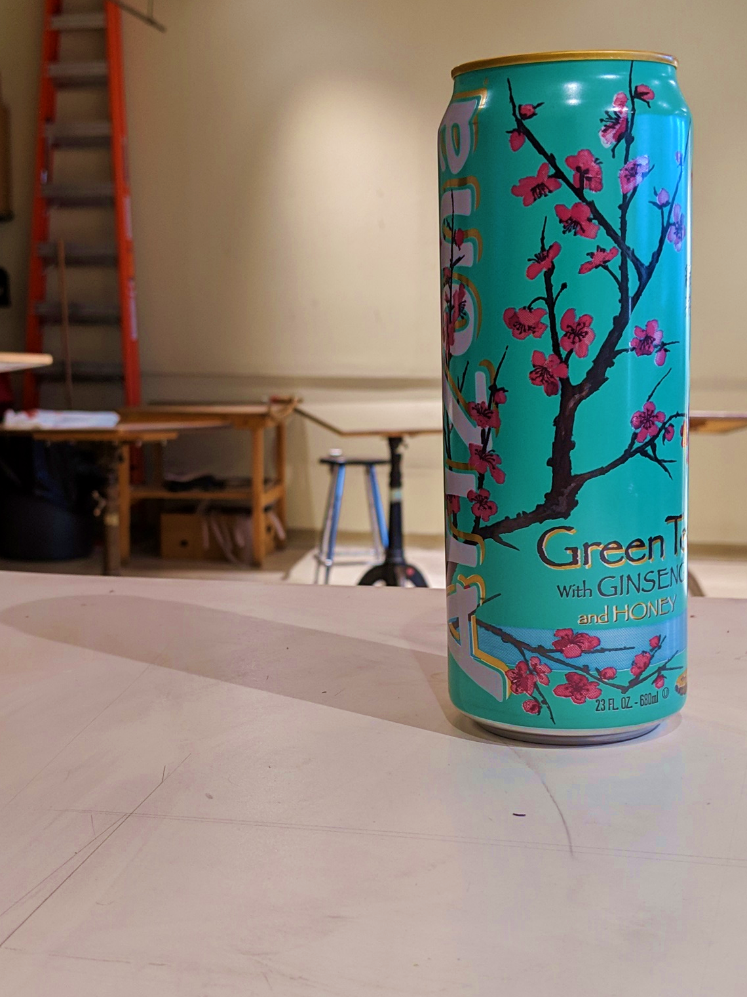
Computer Engineering 186
Spring 2019
Department of Electrical and Computer Engineering
Alexis J. Renderos, William Lavelle, Rolf Anderson, Ritvik Maripally
Adaptive Visual Target Identification and Tracking through
Convolutional Neural Network (CNN) based Machine Learning and Computer Vision
Abstract
The aim of this project is to identify a chosen object of interest at range using a camera feed and an image processing algorithm to assist in the detection, identification and tracking of the target. This solution was then implemented as a rail-mounted tactical scope attachment for a Nerf Blaster. The attachment provides the user with real-time feedback on their aim using a screen mounted on the side of the blaster.
Target Detection and Identification
Target detection and identification is primarily achieved through the implementation of a machine learning based algorithm. A Convolutional Neural Network (CNN) was trained on a dataset of nearly 3,000 photos of the three targets in order to create a comprehensive profile of what the targets looked in the eyes of a digital camera. The resulting model was then used to analyze incoming camera data to locate and identify any potential targets in its field of view.
User Feedback
Mounted on the Nerf Blaster
Data Collection and Analysis
To properly analyze incoming image data, we must first determine the characteristics of our target. The three chosen targets (Fig. 1) were photographed over 1,000 times each in varying lighting conditions and at varying angles and varying degrees of occlusion. This provided us with a set of testing data and training data for our machine learning algorithm. We also analyzed the colors and markings of the targets in addition to the angle of the target relative to the camera and the lighting conditions. This was later used to create an object recognition and tracking algorithm.
Target Tracking
Target tracking is accomplished using a hybridized algorithm known as KCF, or Kernelized Correlation Filters. We chose this algorithm due to its high speed, exceptional accuracy, and excellent failure detection. Unfortunately, KCF does not recover well from full occlusion, but the target tracking algorithm is able to recover from this by implementing the machine learning algorithm.
Conclusion and Analysis
Overall, the CNN based algorithm performed equally in comparison to the purely algorithmic solution. We found that the CNN algorithm had no trouble with identification but struggled heavily when faced with target occlusion. In contrast, the algorithmic solution excelled at recovering from occlusion, but struggled with target identification in extreme light conditions. We believe that with enough training data and training time/epochs that the CNN algorithm will overtake the success of the algorithmic solution.
Hardware Implementation
As a proof of concept, we took our two algorithms and implemented them as a camera based tactical scope attachment for a Nerf Blaster. The computational side was supported by a Raspberry Pi 3 connected to a camera, while power was sourced from the batteries inside the Nerf Blaster.
INPUT
CONVOLUTION + RELU POOLING
CONVOLUTION + RELU POOLING …
FLATTEN
FULLY
CONNECTED
SOFTMAX
FEATURE LEARNING
CLASSIFICATION
Acknowledgements

